Slide 1
GCU KNOWLEDGE HUB
Team Member Details
Team Name : PixelApp
Team Member 1: Gaurav Kumar Das
8th Semester B.Tech(CSE), GIMT Guwahati
Team Member 2 : Bedarchana Sharmah
8th Semester B.Tech(CSE), GIMT Guwahati

Slide 2
WHY GCU KNOWLEDGE HUB?
FOR STUDENTS:
Problem: Students struggle to find a centralized platform for comprehensive quiz practice.
Solution: Caters to students preparing for entrance exams, improving their skills, or reinforcing knowledge.
TECHNOLOGY STACK
Developed using : FLUTTER
Programming Language used: DART
Data Storage: FIREBASE
FOR TEACHERS:
Problem: Difficulty in organizing and managing a vast collection of quiz questions.
Solution: Saves time by easily adding high-quality questions & share them directly with students within the app.

Slide 3
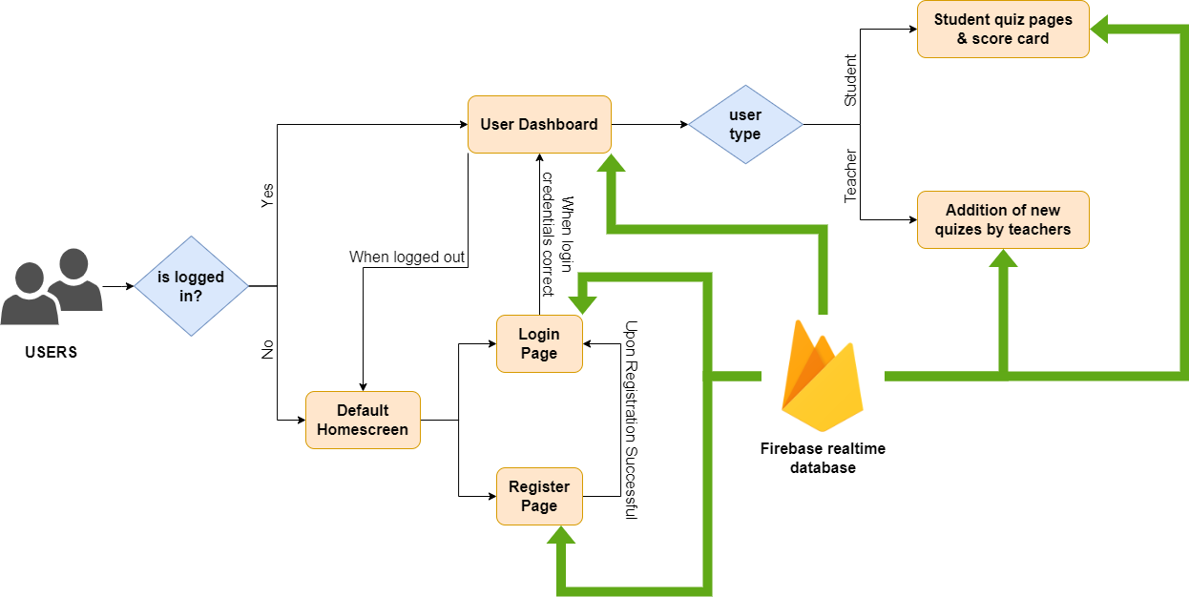
PROJECT WORKFLOW
FIG: Workflow of the app

Slide 4
THANK YOU!!

